Slide 1


Thursday, April 17, 2025
工程项目数据建模与施工模拟计算
Agent-Based Simulation of Construction workflows and Information flow
邱峰
Notes:
城市形态与能源韧性的联系，从城市规划、计算、更新的角度，分析城市韧性的现状、提升未来的韧性，增加城市能源可持续性。

Slide 2
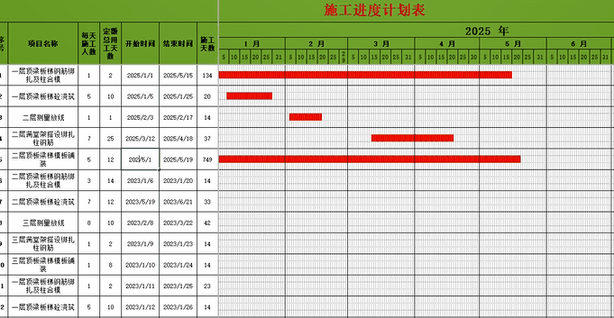
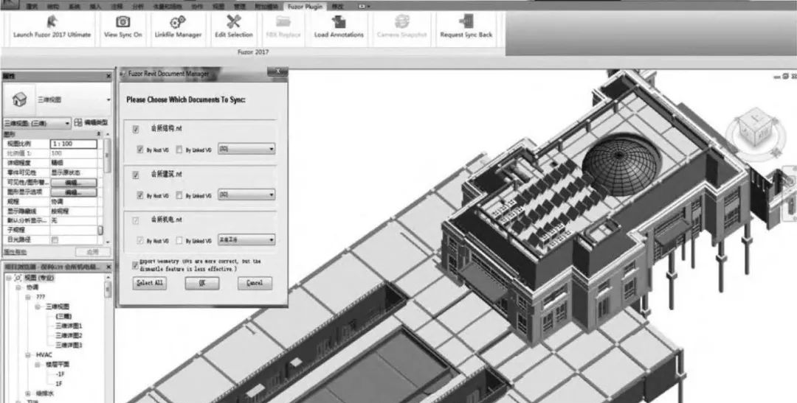
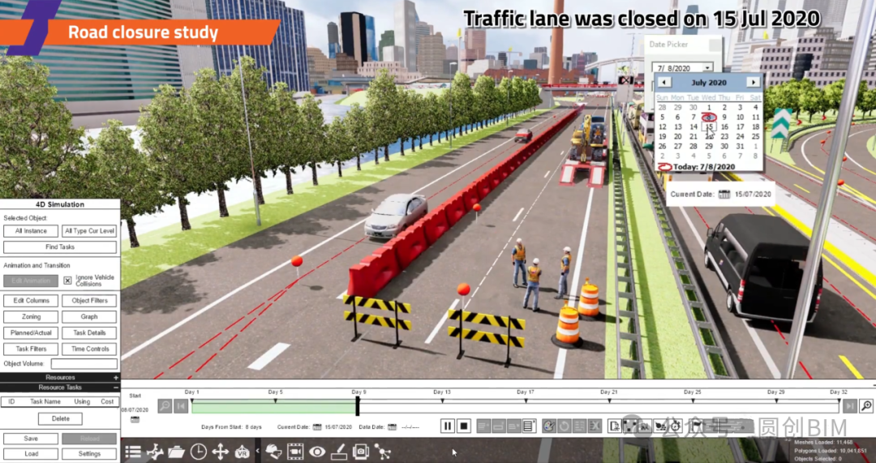
背景1：建筑工程项目的复杂性和工程管理方法
建筑施工项目的复杂性与不确定性是建筑行业面临的重大挑战。甘特图是一种静态的计划工具，无法实时反映施工现场的实际情况，如天气变化、资源短缺、设计变更等。这些不确定性因素会导致计划与实际执行之间的脱节，进而引发一系列问题，如工期延误、成本增加和资源浪费。
为解决这些问题，施工模拟仿真技术被引入，通过建立虚拟模型，对施工过程进行动态模拟和分析，帮助管理者更好地理解和预测施工过程中的各种变化。这种技术能够模拟施工过程中的各种事件和行为，包括资源分配、工序协调、干扰因素等，从而为施工计划的优化提供科学依据。

Slide 3
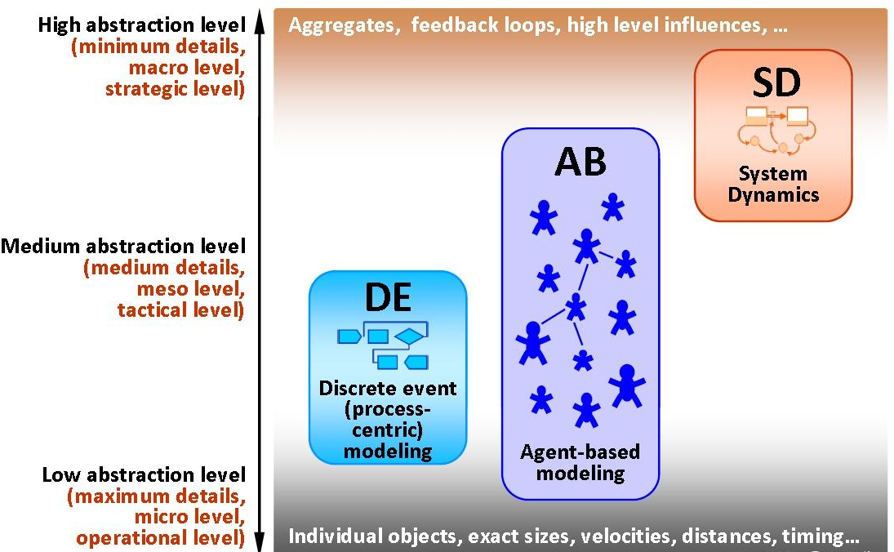
背景2：仿真方法
三大类仿真方法：
SD：System Dynamic
系统动力学，战略层面仿真，强调因果回馈；
AB：Agent-Based
代理人，运营/操作层面仿真，强调互动；
DE：Discrete Event
离散事件，运营/操作层面仿真，强调环环相扣的程序。
离散事件模拟（DES）是一种常用的施工仿真方法，通过事件驱动的方式模拟施工过程中的关键事件和状态变化。然而，DES在处理施工主体的独立行为和动态交互方面存在一定的局限性。
基于代理的仿真则通过模拟施工主体（如工人、机器、任务等）的自主行为和交互，能够更真实地反映施工过程中的复杂性和动态性。
DES：适合模拟事件驱动的系统，如生产流程、排队系统等，强调事件的顺序和时间点。
ABM：适合模拟复杂系统中多个代理之间的交互，如施工中的工人、机器和任务的动态协作。

Slide 4



研究内容：基于代理的施工流程模拟（三个组成部分）
Agent（代理）代表施工过程中的个体（如工人、机器等）。
代理的行为包括但不限于：
Perception change（感知变化）：代理感知环境的变化。
Site meeting（现场会议）：代理之间的沟通和协调。
Decision making（决策制定）：代理根据感知的信息做出决策。
Task（任务）代表具体的施工任务。
任务的属性包括但不限于：
Workspace（工作空间）：任务所需的工作区域。
Workload（工作量）：任务的工作量。
Progress（进度）：任务的完成进度。
Event（事件）代表施工过程中的动态变化。
事件的类型包括但不限于：
Production rate change（生产率变化）：任务的生产率发生变化。
Design change（设计变更）：施工设计的变更。
Quality check（质量检查）：对施工质量的检查。

Slide 5
研究思考+问题提出+基本目标
思考以下问题：
如何以参数化的方式模拟建筑工程中的各种施工活动场景？
如何对工程施工流程中的可变性进行模拟建模与计算？
如何量化分析判断施工现场的信息流的不确定性？
模拟的核心是代理、任务和事件之间的交互。
代理通过感知环境变化、参与现场会议和做出决策来影响任务的执行。
任务的进度和工作量受到事件（如生产率变化、设计变更等）的影响。
在复杂施工项目中，工序依赖、资源分配和不确定性（如工人效率波动、无效工作日）会显著影响项目周期。传统计划工具难以动态反映这些因素。通过基于代理的模拟，可帮助构建一个施工流程与信息流的数字化模型，从而实现：
动态模拟多工种协作资源分配、工序依赖关系和跨楼层施工调度顺序等。
量化模拟分析并计算效率的波动、返工、资源冲突等现实问题产生的影响。
优化资源配置和工期预测。

Slide 6
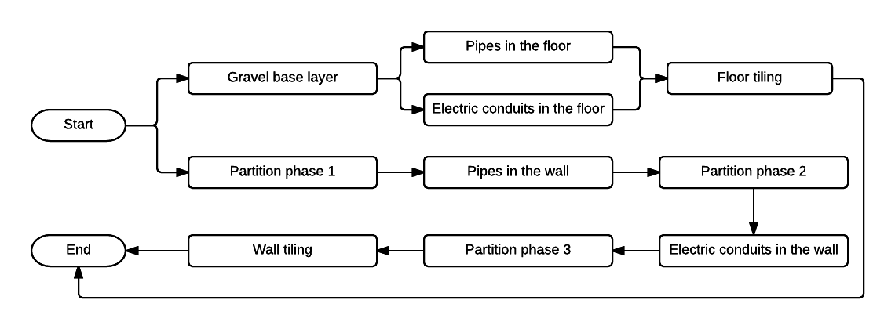
具体应用：一个多工种参与的施工项目案例
基本介绍
Agent-Based Simulation of Construction workflows and Information flow

Slide 7
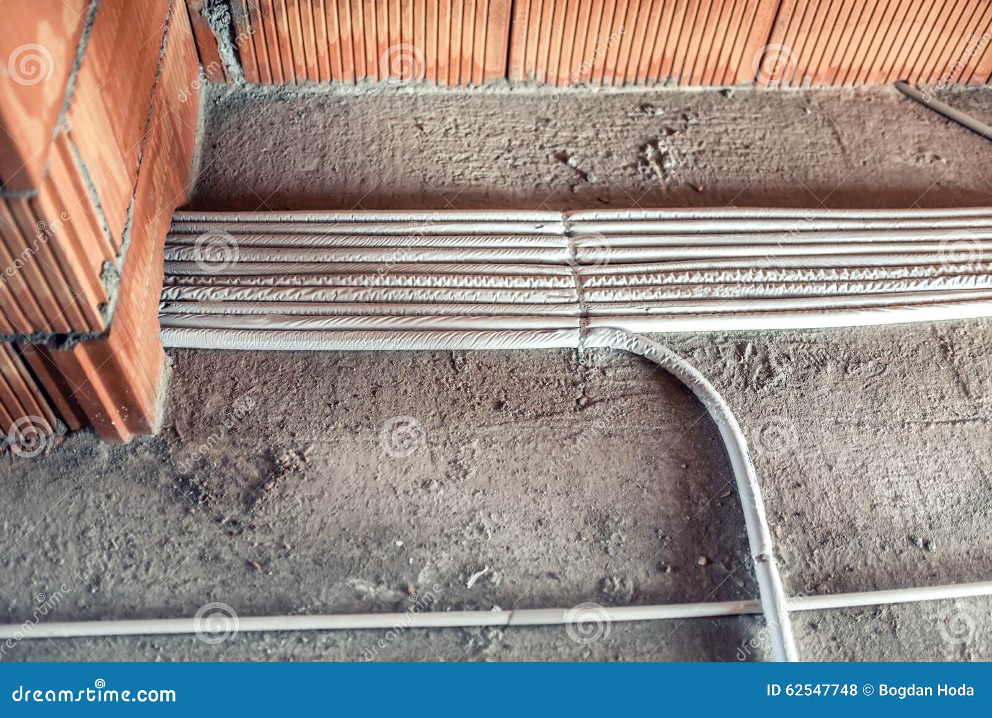
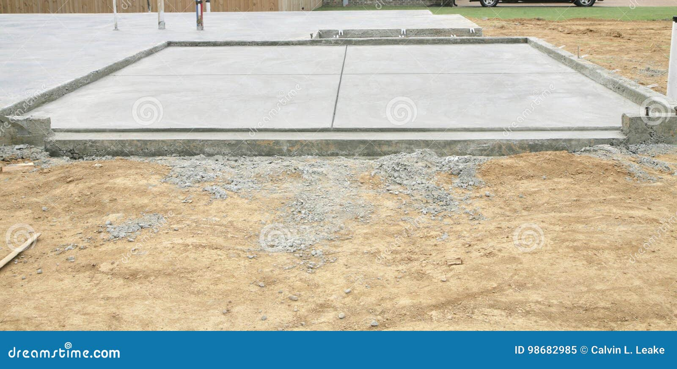

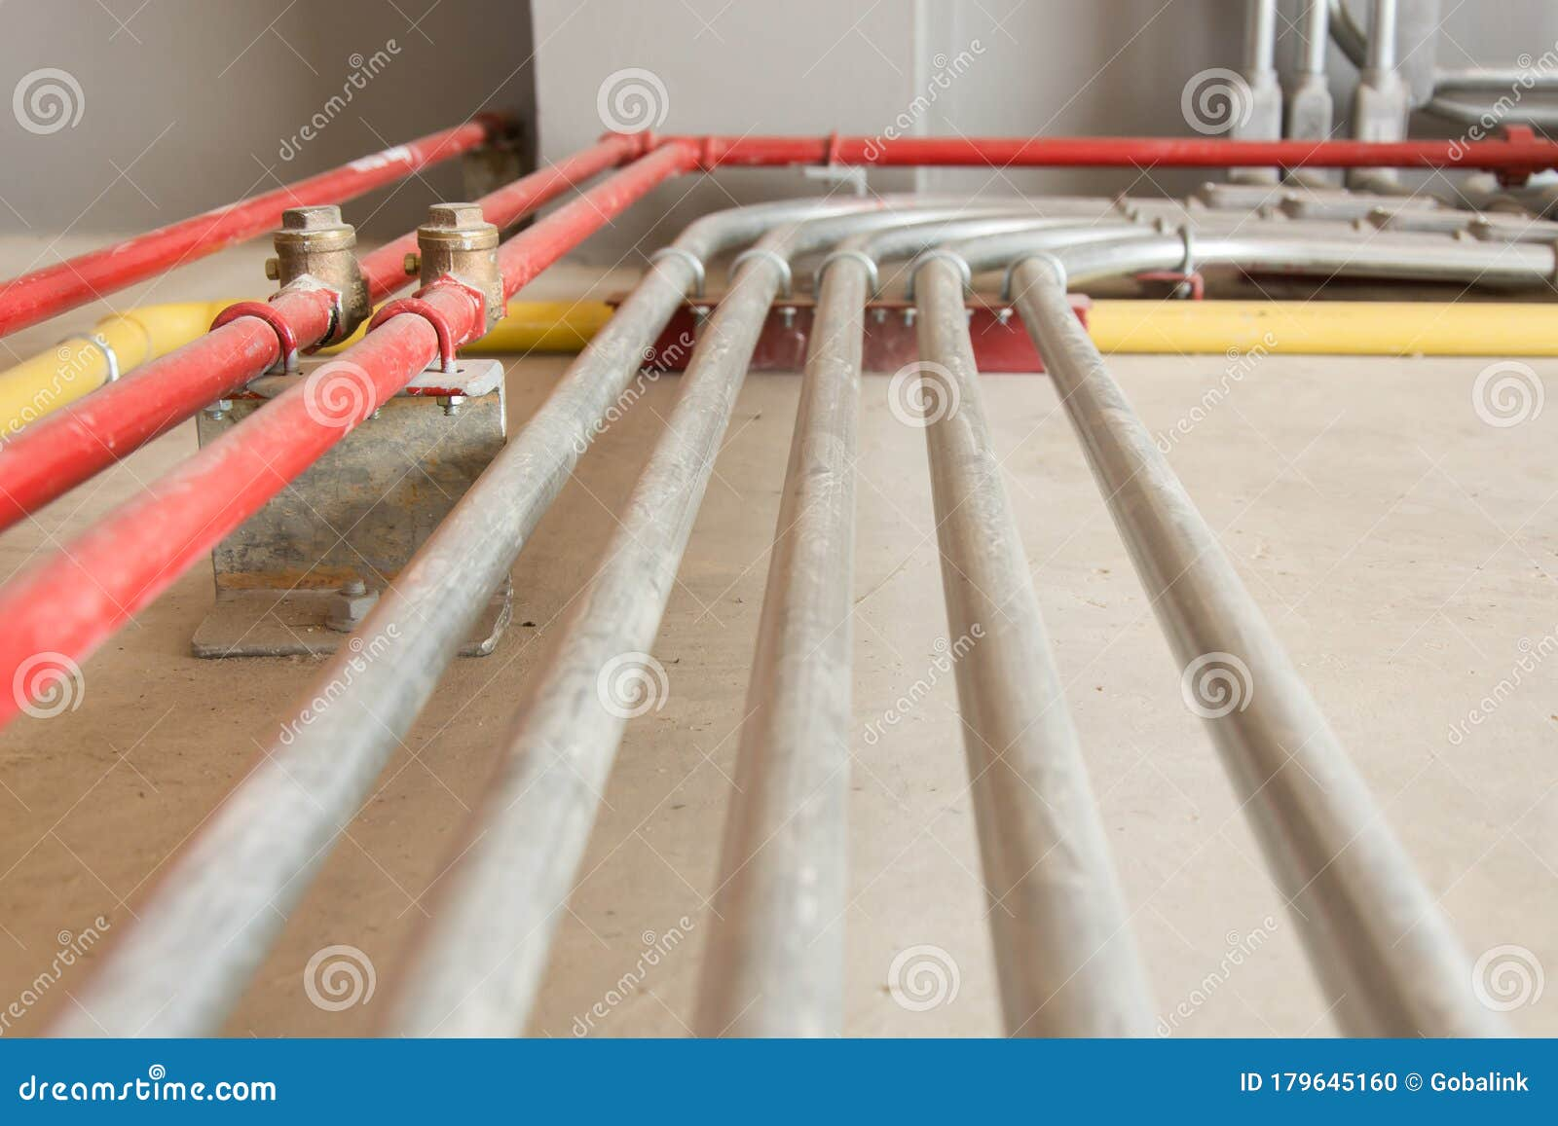
紧前紧后工作1(Dependency)
Pipes in the floor
Gravel base layer
Floor tiling
Electric conduits in the floor

Slide 8
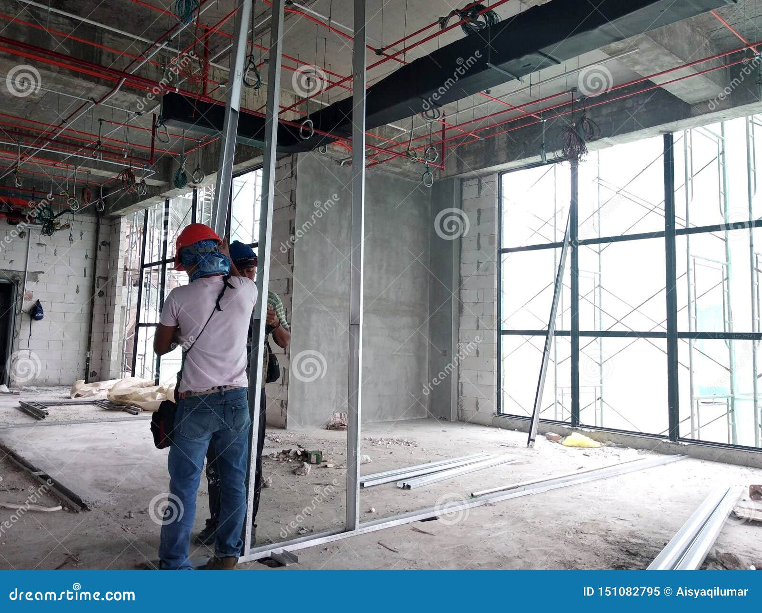
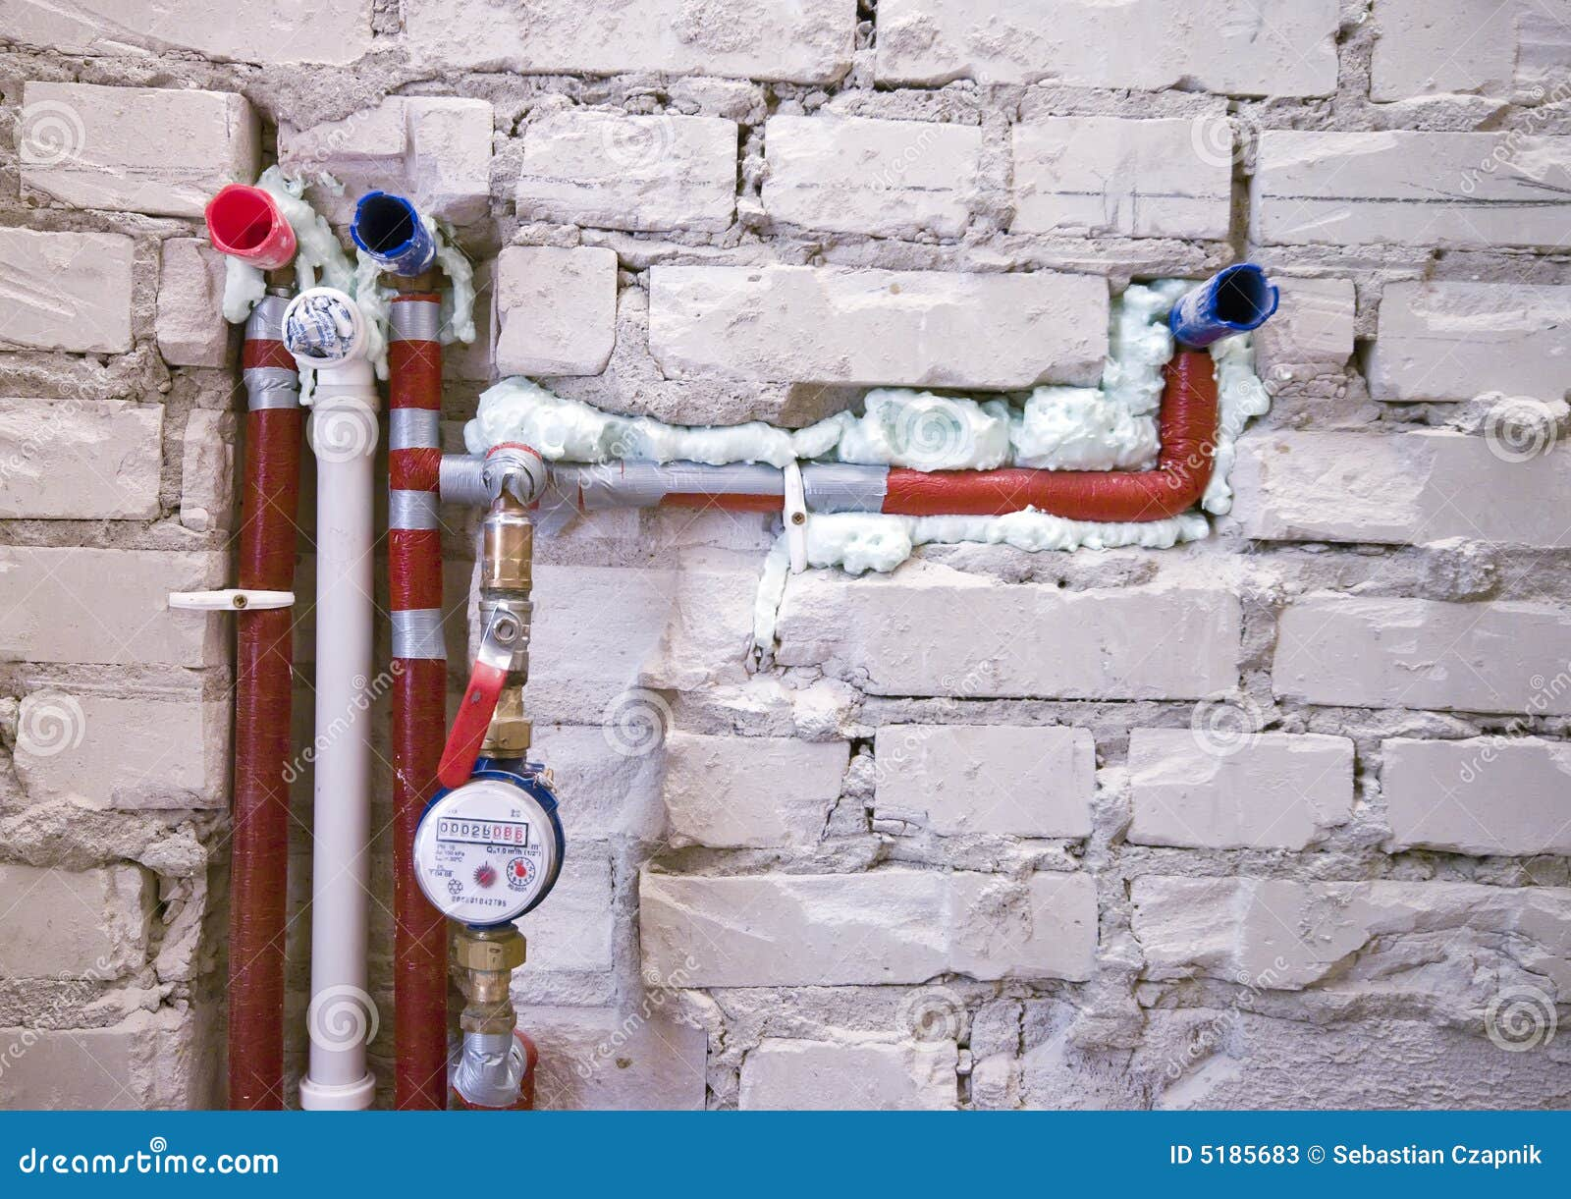
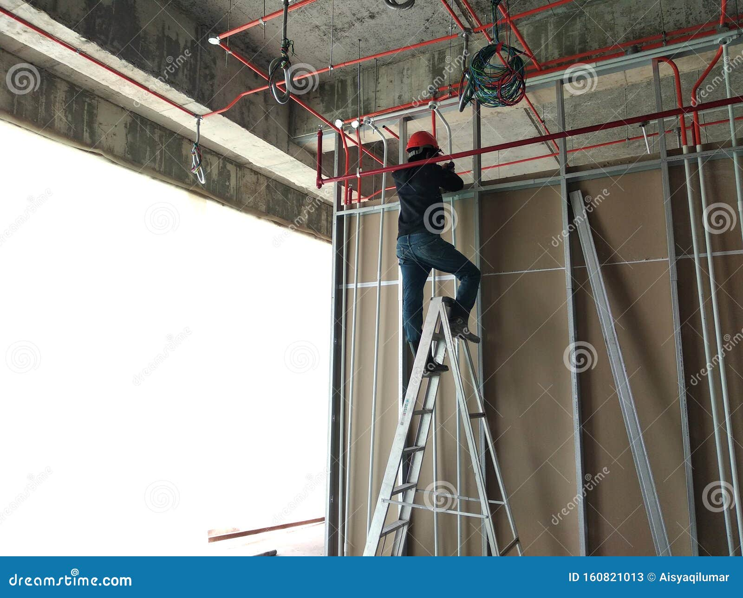

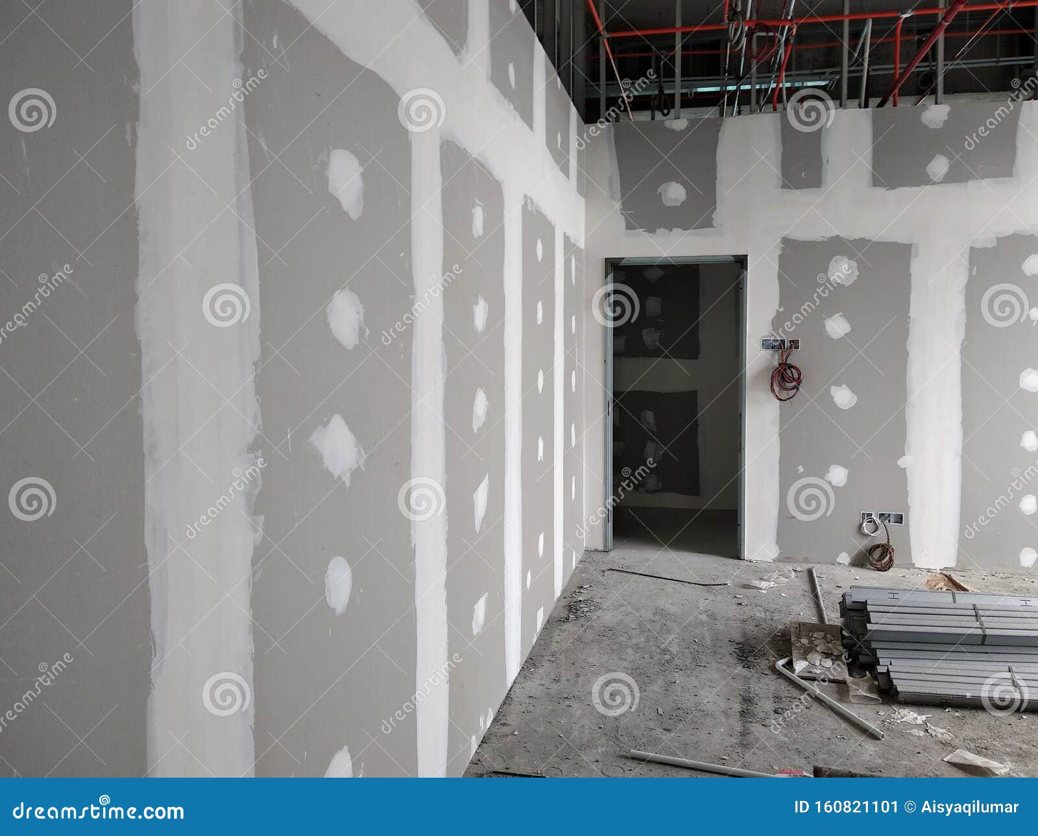


紧前紧后工作2(Dependency)
Partition phase 1
Pipes in the wall
Partition phase 2
Wall tiling
Partition phase 3
Electric conduits in the wall

Slide 9
内容解释
Gravel（碎石工）：负责铺设地基或基础层的碎石，确保地面平整和排水良好。
Plumbing（管道工）：负责安装和维护供水、排水和卫生设施的管道系统。
Electricity（电工）：负责安装和维护电气系统，包括照明、插座、开关和配电箱。
Tiling（瓷砖工）：负责铺设地板和墙面的瓷砖，确保美观和耐用。
Partition（隔墙工）：负责建造和安装隔墙，将空间分隔成不同的功能区域。
id | Trade | …
1 | Gravel | …
2 | Plumbing | …
3 | Electricity | …
4 | Tiling | …
5 | Partition | …

Slide 10
内容解释
这种设计会导致什么问题？
Process（工作内容）
Gravel base layer
Pipes in the floor
Electric conduits in the floor
Floor tiling
Partition phase 1
Pipes in the wall
Electric conduits in the wall
Partition phase 2
Wall tiling
Partition phase 3
工种 | 负责的工序列表
电工 | 地板下的电线管道, 墙体内的电线管道
瓦工 | 铺地砖, 铺墙砖
管道工 | 地板下的水管, 墙体内的水管
隔断工 | 分区阶段1, 分区阶段2, 分区阶段3
碎石工 | 碎石基层
id | Process | Trade
1 | Electric conduits in the floor | Electricity
2 | Electric conduits in the wall | Electricity
3 | Floor tiling | Tiling
4 | Gravel base layer | Gravel
5 | Partition phase 1 | Partition
6 | Partition phase 2 | Partition
7 | Partition phase 3 | Partition
8 | Pipes in the floor | Plumbing
9 | Pipes in the wall | Plumbing
10 | Wall tiling | Tiling
数据不重复
查询方便
扩展灵活
核心原则：每个表只做一件事，用编号关联信息，而不是堆砌数据。
Notes:
重复劳动：每次新增一个工序（例如电工的“天花板电线管道”），都要修改“电工”行的“负责的工序列表”。
查询困难：想统计“电工负责多少工序”，必须拆分“负责的工序列表”字段，非常麻烦。
…

Slide 11
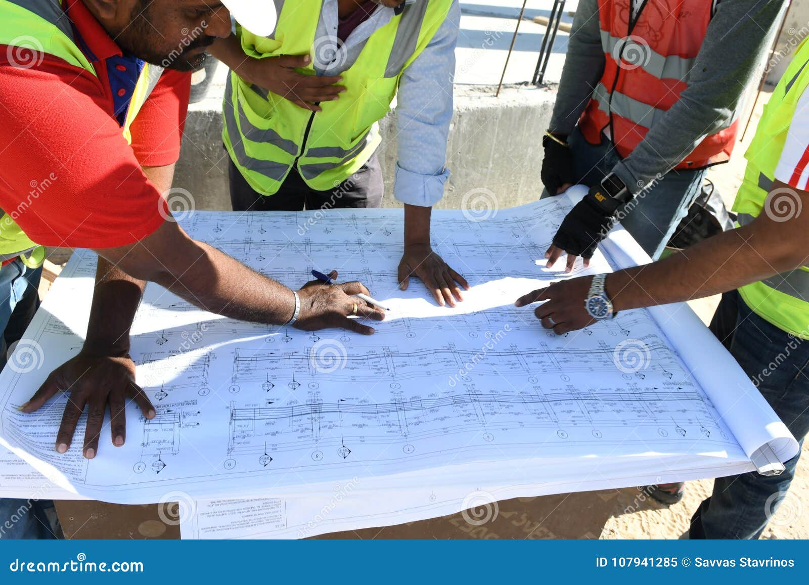
具体数据：一个多工种参与的施工项目案例
所用到的数据（模拟计算）
id | Trade | Number of people
1 | Gravel | 1
2 | Plumbing | 1
3 | Electricity | 1
4 | Tiling | 1
5 | Partition | 1
Space | InitialPriority
1 | 5
2 | 4
3 | 3
4 | 2
5 | 1
Process | Floor | InitialQuantity | Design Change Variation
Gravel base layer | 1 | 170 | 17
Pipes in the floor | 1 | 100 | 10
Electric conduits in the floor | 1 | 80 | 8
Floor tiling | 1 | 720 | 72
Partition phase 1 | 1 | 750 | 75
Pipes in the wall | 1 | 190 | 19
Electric conduits in the wall | 1 | 180 | 18
Partition phase 2 | 1 | 20 | 2
Wall tiling | 1 | 290 | 29
Partition phase 3 | 1 | 200 | 20
… | … | … | …
id | Process | Trade | InitialProductionRate | QualityRate | PerformanceStd
1 | Electric conduits in the floor | Electricity | 51 | 0.9 | 8
2 | Electric conduits in the wall | Electricity | 41 | 0.9 | 2
3 | Floor tiling | Tiling | 62 | 0.9 | 9
4 | Gravel base layer | Gravel | 34 | 0.9 | 5
5 | Partition phase 1 | Partition | 55 | 0.9 | 12
6 | Partition phase 2 | Partition | 51 | 0.9 | 11
7 | Partition phase 3 | Partition | 32 | 0.9 | 4
8 | Pipes in the floor | Plumbing | 69 | 0.9 | 5
9 | Pipes in the wall | Plumbing | 37 | 0.9 | 9
10 | Wall tiling | Tiling | 27 | 0.9 | 2
PredecessorProcess | SuccessorProcess
Gravel base layer | Pipes in the floor
Gravel base layer | Electric conduits in the floor
Pipes in the floor | Floor tiling
Electric conduits in the floor | Floor tiling
Partition phase 1 | Pipes in the wall
Pipes in the wall | Partition phase 2
Partition phase 2 | Electric conduits in the wall
Electric conduits in the wall | Partition phase 3
Partition phase 3 | Wall tiling

Slide 12
数据解释：工种(Trade) & 任务(Process)
Gravel（碎石工）：负责铺设地基或基础层的碎石，确保地面平整和排水良好。
Plumbing（管道工）：负责安装和维护供水、排水和卫生设施的管道系统。
Electricity（电工）：负责安装和维护电气系统，包括照明、插座、开关和配电箱。
Tiling（瓷砖工）：负责铺设地板和墙面的瓷砖，确保美观和耐用。
Partition（隔墙工）：负责建造和安装隔墙，将空间分隔成不同的功能区域。
id | Process | Trade | InitialProductionRate | QualityRate | PerformanceStd
1 | Electric conduits in the floor | Electricity | 51 | 0.9 | 8
2 | Electric conduits in the wall | Electricity | 41 | 0.9 | 2
3 | Floor tiling | Tiling | 62 | 0.9 | 9
4 | Gravel base layer | Gravel | 34 | 0.9 | 5
5 | Partition phase 1 | Partition | 55 | 0.9 | 12
6 | Partition phase 2 | Partition | 51 | 0.9 | 11
7 | Partition phase 3 | Partition | 32 | 0.9 | 4
8 | Pipes in the floor | Plumbing | 69 | 0.9 | 5
9 | Pipes in the wall | Plumbing | 37 | 0.9 | 9
10 | Wall tiling | Tiling | 27 | 0.9 | 2
id | Process | Trade
1 | Electric conduits in the floor | Electricity
2 | Electric conduits in the wall | Electricity
3 | Floor tiling | Tiling
4 | Gravel base layer | Gravel
5 | Partition phase 1 | Partition
6 | Partition phase 2 | Partition
7 | Partition phase 3 | Partition
8 | Pipes in the floor | Plumbing
9 | Pipes in the wall | Plumbing
10 | Wall tiling | Tiling
id | Trade | Number of people
1 | Gravel | 1
2 | Plumbing | 1
3 | Electricity | 1
4 | Tiling | 1
5 | Partition | 1

Slide 13
数据解释：得出关联表(Dependency)
Space | InitialPriority
1 | 5
2 | 4
3 | 3
4 | 2
5 | 1
PredecessorProcess | SuccessorProcess
Gravel base layer | Pipes in the floor
Gravel base layer | Electric conduits in the floor
Pipes in the floor | Floor tiling
Electric conduits in the floor | Floor tiling
Partition phase 1 | Pipes in the wall
Pipes in the wall | Partition phase 2
Partition phase 2 | Electric conduits in the wall
Electric conduits in the wall | Partition phase 3
Partition phase 3 | Wall tiling
Process | Floor | InitialQuantity | Design Change Variation
Gravel base layer | 1 | 170 | 17
Pipes in the floor | 1 | 100 | 10
Electric conduits in the floor | 1 | 80 | 8
Floor tiling | 1 | 720 | 72
Partition phase 1 | 1 | 750 | 75
Pipes in the wall | 1 | 190 | 19
Electric conduits in the wall | 1 | 180 | 18
Partition phase 2 | 1 | 20 | 2
Wall tiling | 1 | 290 | 29
Partition phase 3 | 1 | 200 | 20
… | … | … | …

Slide 14
数据说明1：Trade的初始效率(Initial Production Rate)
-- 初始化工种资源：插入所有工种，默认可用工人数为1
Gravel（碎石工）：负责铺设地基或基础层的碎石，确保地面平整和排水良好。
Plumbing（管道工）：负责安装和维护供水、排水和卫生设施的管道系统。
Electricity（电工）：负责安装和维护电气系统，包括照明、插座、开关和配电箱。
Tiling（瓷砖工）：负责铺设地板和墙面的瓷砖，确保美观和耐用。
Partition（隔墙工）：负责建造和安装隔墙，将空间分隔成不同的功能区域。
id | Trade | Number of people | …
1 | Gravel | 1 | …
2 | Plumbing | 1 | …
3 | Electricity | 1 | …
4 | Tiling | 1 | …
5 | Partition | 1 | …
id | Process | Trade | InitialProductionRate | QualityRate | PerformanceStd
1 | Electric conduits in the floor | Electricity | 51 | 0.9 | 8
2 | Electric conduits in the wall | Electricity | 41 | 0.9 | 2
3 | Floor tiling | Tiling | 62 | 0.9 | 9
4 | Gravel base layer | Gravel | 34 | 0.9 | 5
5 | Partition phase 1 | Partition | 55 | 0.9 | 12
6 | Partition phase 2 | Partition | 51 | 0.9 | 11
7 | Partition phase 3 | Partition | 32 | 0.9 | 4
8 | Pipes in the floor | Plumbing | 69 | 0.9 | 5
9 | Pipes in the wall | Plumbing | 37 | 0.9 | 9
10 | Wall tiling | Tiling | 27 | 0.9 | 2
指施工中的表现或性能，如施工效率、质量等…
是否返工的问题后面简化为随机10%无效，实际上可随需求对每个Trade（具体到人）进行设计。
同时每个人的Performance可能按照一定分布变化（例如正态分布），所以增加属性到Trade表中即可。
-- 生成10%无效日概率
is_invalid := (random() < 0.1);
-- 计算实际完成量：无效日为0，否则…
work_done := CASE
WHEN is_invalid THEN 0
ELSE GREATEST(1, ROUND(task_rec.initial_production_rate * (0.9 + 0.2 * random())) * task_rec.available_workers)
END;

Slide 15
数据说明2：Process的初始总量(Initial Quantity)
('Gravel base layer', ROUND(170 * (0.9 + 0.2 * random()))::INT, 170),
('Pipes in the floor', ROUND(100 * (0.9 + 0.2 * random()))::INT, 100),
('Electric conduits in the floor', ROUND(80 * (0.9 + 0.2 * random()))::INT, 80),
('Floor tiling', ROUND(720 * (0.9 + 0.2 * random()))::INT, 720),
('Partition phase 1', ROUND(750 * (0.9 + 0.2 * random()))::INT, 750),
('Pipes in the wall', ROUND(190 * (0.9 + 0.2 * random()))::INT, 190),
('Electric conduits in the wall', ROUND(180 * (0.9 + 0.2 * random()))::INT, 180),
('Partition phase 2', ROUND(20 * (0.9 + 0.2 * random()))::INT, 20),
('Wall tiling', ROUND(290 * (0.9 + 0.2 * random()))::INT, 290),
('Partition phase 3', ROUND(200 * (0.9 + 0.2 * random()))::INT, 200);
Process | Floor | InitialQuantity | Design Change Variation
Gravel base layer | 1 | 170 | 17
Pipes in the floor | 1 | 100 | 10
Electric conduits in the floor | 1 | 80 | 8
Floor tiling | 1 | 720 | 72
Partition phase 1 | 1 | 750 | 75
Pipes in the wall | 1 | 190 | 19
Electric conduits in the wall | 1 | 180 | 18
Partition phase 2 | 1 | 20 | 2
Wall tiling | 1 | 290 | 29
Partition phase 3 | 1 | 200 | 20
… | … | … | …

Slide 16
过程模拟-daily task details 初始化
第0天：数据初始化，找到开工的项目。
day | floor | process | trade | Initial Quantity | status | Initial production rate | Remain work | Predecessor processes | Pre Remain work | Trade available | Prerequisite completed | Can Start?
0 | 1 | Electric conduits in the floor | Electricity | 74 | pending | 51 | 74 | Gravel base layer | 154 | 1 | FALSE | FALSE
0 | 1 | Electric conduits in the wall | Electricity | 164 | pending | 41 | 164 | Partition phase 2 | 19 | 1 | FALSE | FALSE
0 | 1 | Floor tiling | Tiling | 661 | pending | 62 | 661 | Pipes in the floor, Electric conduits in the floor | 74, 103 | 1 | FALSE | FALSE
0 | 1 | Gravel base layer | Gravel | 154 | pending | 34 | 154 | null | null | 1 | TRUE | TRUE
0 | 1 | Partition phase 1 | Partition | 818 | pending | 55 | 818 | null | null | 1 | TRUE | TRUE
0 | 1 | Partition phase 2 | Partition | 19 | pending | 51 | 19 | Pipes in the wall | 175 | 1 | FALSE | FALSE
0 | 1 | Partition phase 3 | Partition | 216 | pending | 32 | 216 | Electric conduits in the wall | 164 | 1 | FALSE | FALSE
0 | 1 | Pipes in the floor | Plumbing | 103 | pending | 69 | 103 | Gravel base layer | 154 | 1 | FALSE | FALSE
0 | 1 | Pipes in the wall | Plumbing | 175 | pending | 37 | 175 | Partition phase 1 | 818 | 1 | FALSE | FALSE
0 | 1 | Wall tiling | Tiling | 271 | pending | 27 | 271 | Partition phase 3 | 216 | 1 | FALSE | FALSE
0 | 1 | Floor tiling | Tiling | 661 | pending | 62 | 661 | Pipes in the floor | 74 | 1 | FALSE | FALSE
0 | 1 | Floor tiling | Tiling | 661 | pending | 62 | 661 | Electric conduits in the floor | 103 | 1 | FALSE | FALSE
Notes:
在数据库设计中，“一对多”和“多对一”本质上是同一关系的两种视角，但实践中更推荐将外键放在“多”的一方（即多对一的设计），这与关系数据库的规范化理论密切相关。
关系数据库设计遵循规范化理论（Normalization），目标是消除数据冗余、保证数据一致性、简化更新操作。
核心思想是：
第一范式（1NF）：确保字段的原子性（不可再分），例如不能在一个字段中存储列表或集合。
第三范式（3NF）：消除非主属性对主键的传递依赖。

Slide 17
过程模拟-第一天情况
day | process | Assigned trade | Initial Quantity | status | ipr | Actual efficiency | Remain work | Is rework | Today workload | Predecessor processes | pre_remain_work | trade_available
1 | Electric conduits in the floor | Electricity | 74 | pending | 51 | null | 74 | null | 0 | Gravel base layer | 122 | 1
1 | Electric conduits in the wall | Electricity | 164 | pending | 41 | null | 164 | null | 0 | Partition phase 2 | 19 | 1
1 | Floor tiling | Tiling | 661 | pending | 62 | null | 661 | null | 0 | Pipes in the floor, Electric conduits in the floor | 74, 103 | 1
1 | Gravel base layer | Gravel | 154 | in_progress | 34 | 32 | 122 | FALSE | 32 | null | null | 0
1 | Partition phase 1 | Partition | 818 | in_progress | 55 | 58 | 760 | FALSE | 58 | null | null | 0
1 | Partition phase 2 | Partition | 19 | pending | 51 | null | 19 | null | 0 | Pipes in the wall | 175 | 0
1 | Partition phase 3 | Partition | 216 | pending | 32 | null | 216 | null | 0 | Electric conduits in the wall | 164 | 0
1 | Pipes in the floor | Plumbing | 103 | pending | 69 | null | 103 | null | 0 | Gravel base layer | 122 | 1
1 | Pipes in the wall | Plumbing | 175 | pending | 37 | null | 175 | null | 0 | Partition phase 1 | 760 | 1
1 | Wall tiling | Tiling | 271 | pending | 27 | null | 271 | null | 0 | Partition phase 3 | 216 | 1

Slide 18
过程模拟-“pre remain work=0” & “trade available”
Gravel base layer (floor 1)
day | floor | process | assigned_trade | task_status | initial_production_rate | remain_work | is_rework | trade_available | can_start
0 | 1 | Gravel base layer | Gravel | pending | 34 | 154 | null | 1 | TRUE
1 | 1 | Gravel base layer | Gravel | in_progress | 34 | 122 | FALSE | 0 | FALSE
2 | 1 | Gravel base layer | Gravel | in_progress | 34 | 90 | FALSE | 0 | FALSE
3 | 1 | Gravel base layer | Gravel | in_progress | 34 | 58 | FALSE | 0 | FALSE
4 | 1 | Gravel base layer | Gravel | in_progress | 34 | 25 | FALSE | 0 | FALSE
5 | 1 | Gravel base layer | Gravel | completed | 34 | 0 | FALSE | 1 | FALSE
Electric conduits in the floor (floor 1)
day | floor | process | trade | IQ | status | ipr | remain | workload | predecessor_processes | pre_remain_work | trade_available | can_start
5 | 1 | Electric conduits in the floor | Electricity | 74 | pending | 51 | 74 | 0 | Gravel base layer | 0 | 1 | TRUE
6 | 1 | Electric conduits in the floor | Electricity | 74 | in_progress | 51 | 18 | 56 | Gravel base layer | 0 | 0 | FALSE
7 | 1 | Electric conduits in the floor | Electricity | 74 | completed | 51 | 0 | 18 | Gravel base layer | 0 | 1 | FALSE
Pipes in the floor (floor 1)
day | floor | process | trade | IQ | task_status | ipr | remain | workload | predecessor_processes | pre_remain_work | trade_available | can_start
5 | 1 | Pipes in the floor | Plumbing | 103 | pending | 69 | 103 | 0 | Gravel base layer | 0 | 1 | TRUE
6 | 1 | Pipes in the floor | Plumbing | 103 | in_progress | 69 | 31 | 72 | Gravel base layer | 0 | 0 | FALSE
7 | 1 | Pipes in the floor | Plumbing | 103 | completed | 69 | 0 | 31 | Gravel base layer | 0 | 1 | FALSE
Gravel base layer (floor 2)
day_number | floor | process | assigned_trade | task_status | remain_work | trade_available | can_start
4 | 2 | Gravel base layer | Gravel | pending | 154 | 0 | FALSE
5 | 2 | Gravel base layer | Gravel | pending | 154 | 1 | TRUE
6 | 2 | Gravel base layer | Gravel | in_progress | 121 | 0 | FALSE
7 | 2 | Gravel base layer | Gravel | in_progress | 84 | 0 | FALSE
8 | 2 | Gravel base layer | Gravel | in_progress | 49 | 0 | FALSE
9 | 2 | Gravel base layer | Gravel | in_progress | 14 | 0 | FALSE
10 | 2 | Gravel base layer | Gravel | completed | 0 | 1 | FALSE

Slide 19
过程模拟-Trade available情况分析（Partition为例）
day_number | floor | process | assigned_trade | predecessor_processes | pre_remain_work | can_start
0 | 1 | Partition phase 1 | Partition | null | null | TRUE
0 | 2 | Partition phase 1 | Partition | null | null | TRUE
0 | 3 | Partition phase 1 | Partition | null | null | TRUE
0 | 4 | Partition phase 1 | Partition | null | null | TRUE
0 | 5 | Partition phase 1 | Partition | null | null | TRUE
0 | 1 | Partition phase 2 | Partition | Pipes in the wall | 175 | FALSE
0 | 2 | Partition phase 2 | Partition | Pipes in the wall | 175 | FALSE
0 | 3 | Partition phase 2 | Partition | Pipes in the wall | 175 | FALSE
0 | 4 | Partition phase 2 | Partition | Pipes in the wall | 175 | FALSE
0 | 5 | Partition phase 2 | Partition | Pipes in the wall | 175 | FALSE
0 | 1 | Partition phase 3 | Partition | Electric conduits in the wall | 164 | FALSE
0 | 2 | Partition phase 3 | Partition | Electric conduits in the wall | 164 | FALSE
0 | 3 | Partition phase 3 | Partition | Electric conduits in the wall | 164 | FALSE
0 | 4 | Partition phase 3 | Partition | Electric conduits in the wall | 164 | FALSE
0 | 5 | Partition phase 3 | Partition | Electric conduits in the wall | 164 | FALSE
day | floor | process | assigned_trade | predecessor_processes | pre_remain | can_start
55 | 2 | Partition phase 2 | Partition | Pipes in the wall | 0 | TRUE
55 | 1 | Partition phase 3 | Partition | Electric conduits in the wall | 0 | TRUE
Space | InitialPriority
1 | 5
2 | 4
3 | 3
4 | 2
5 | 1
增加一列（floor优先级），从而判断开工项目。

Slide 20
过程模拟-单个process结果（是否有无效day）
day | floor | process | trade | IQ | task_status | ipr | actual | remain_work | is_rework | today_workload | trade_available | can_start
0 | 2 | Gravel base layer | Gravel | 154 | pending | 34 | null | 154 | null | null | 1 | TRUE
1 | 2 | Gravel base layer | Gravel | 154 | pending | 34 | null | 154 | null | 0 | 0 | FALSE
2 | 2 | Gravel base layer | Gravel | 154 | pending | 34 | null | 154 | null | 0 | 0 | FALSE
3 | 2 | Gravel base layer | Gravel | 154 | pending | 34 | null | 154 | null | 0 | 0 | FALSE
4 | 2 | Gravel base layer | Gravel | 154 | pending | 34 | null | 154 | null | 0 | 0 | FALSE
5 | 2 | Gravel base layer | Gravel | 154 | pending | 34 | null | 154 | null | 0 | 1 | TRUE
6 | 2 | Gravel base layer | Gravel | 154 | in_progress | 34 | 33 | 121 | FALSE | 33 | 0 | FALSE
7 | 2 | Gravel base layer | Gravel | 154 | in_progress | 34 | 37 | 84 | FALSE | 37 | 0 | FALSE
8 | 2 | Gravel base layer | Gravel | 154 | in_progress | 34 | 35 | 49 | FALSE | 35 | 0 | FALSE
9 | 2 | Gravel base layer | Gravel | 154 | in_progress | 34 | 35 | 14 | FALSE | 35 | 0 | FALSE
10 | 2 | Gravel base layer | Gravel | 154 | completed | 34 | 37 | 0 | FALSE | 14 | 1 | FALSE
day | floor | process | assigned_trade | planned_remaining | task_status | initial_production_rate | actual_efficiency | remain_work | is_rework | today_workload
10 | 3 | Gravel base layer | Gravel | 154 | pending | 34 | null | 154 | null | 0
11 | 3 | Gravel base layer | Gravel | 154 | in_progress | 34 | 35 | 119 | FALSE | 35
12 | 3 | Gravel base layer | Gravel | 154 | in_progress | 34 | 0 | 119 | TRUE | 0
13 | 3 | Gravel base layer | Gravel | 154 | in_progress | 34 | 0 | 119 | TRUE | 0
14 | 3 | Gravel base layer | Gravel | 154 | in_progress | 34 | 36 | 83 | FALSE | 36
15 | 3 | Gravel base layer | Gravel | 154 | in_progress | 34 | 35 | 48 | FALSE | 35
16 | 3 | Gravel base layer | Gravel | 154 | in_progress | 34 | 33 | 15 | FALSE | 33
17 | 3 | Gravel base layer | Gravel | 154 | completed | 34 | 31 | 0 | FALSE | 15
…

Slide 21
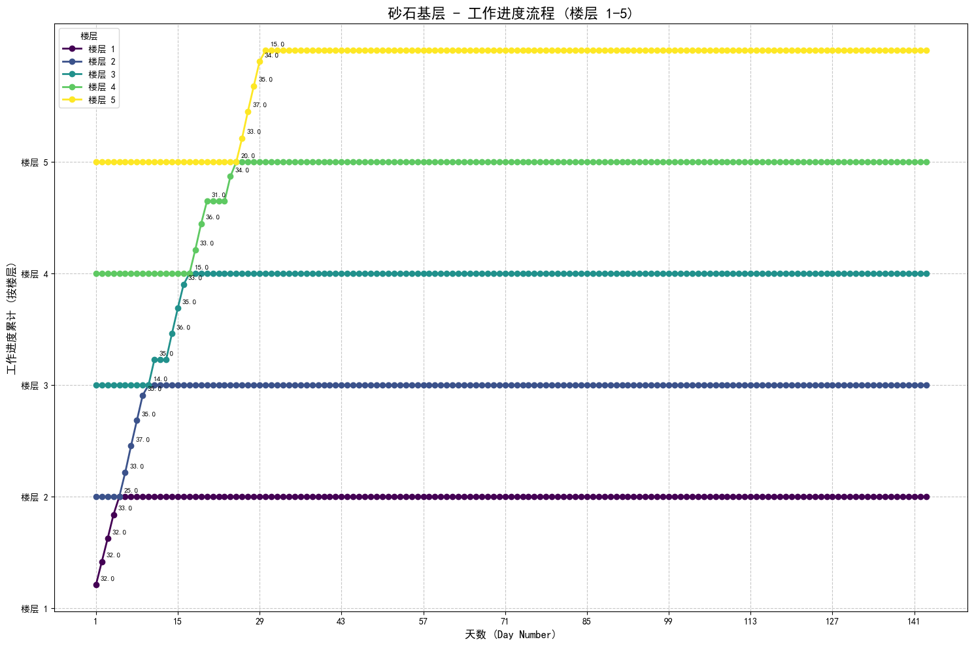
Gravel base layer

Slide 22
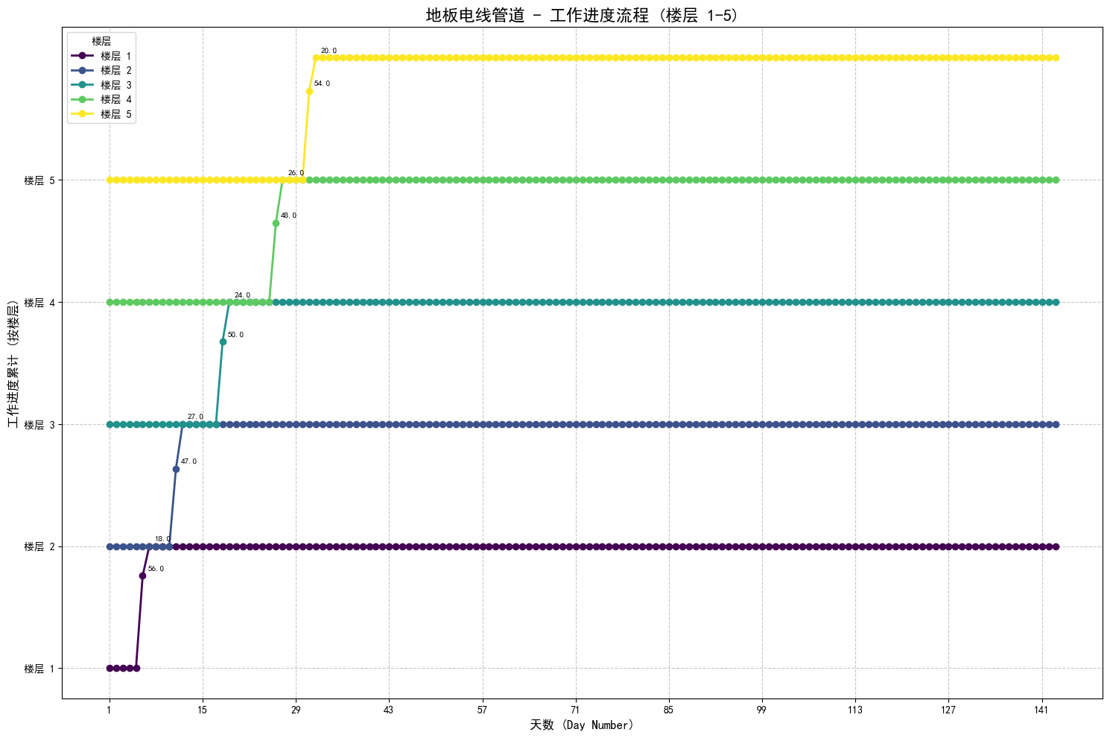
Electric conduits in the floor

Slide 23
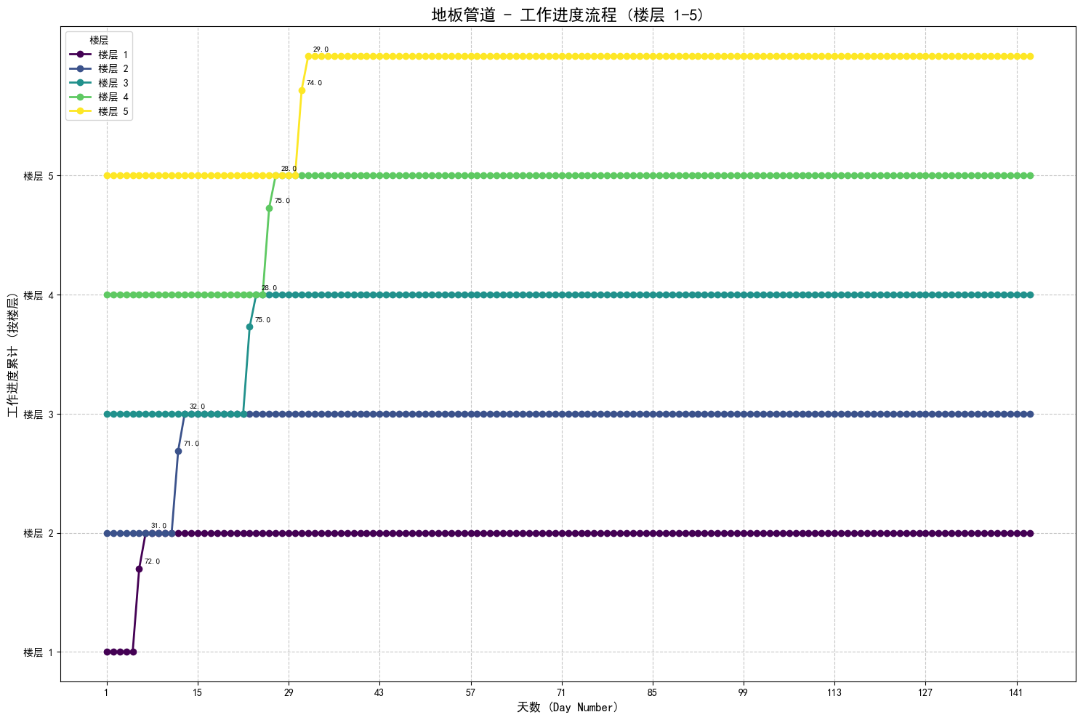
Pipes in the floor

Slide 24
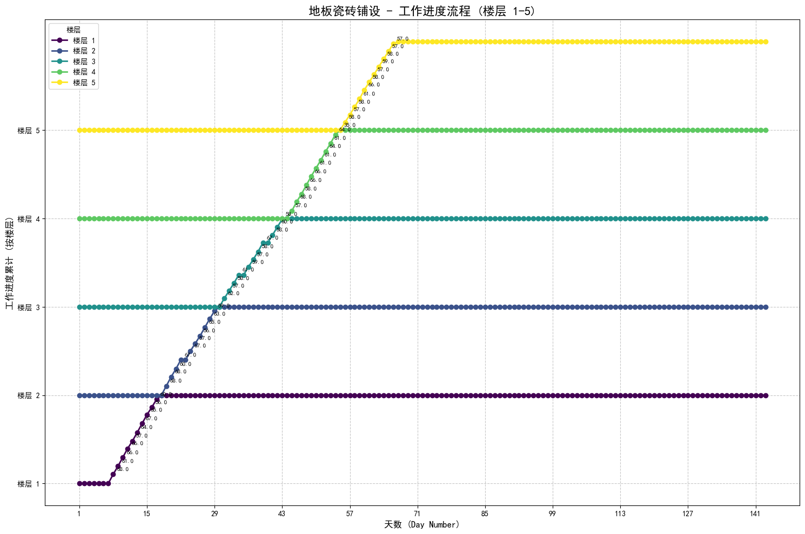
Floor tiling

Slide 25
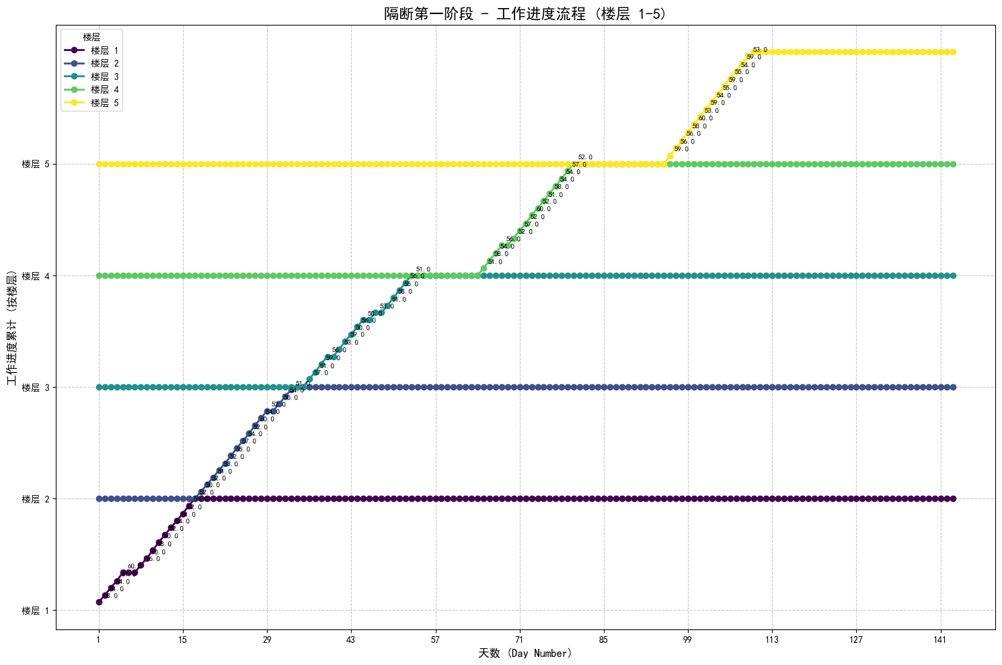
Partition phase 1

Slide 26
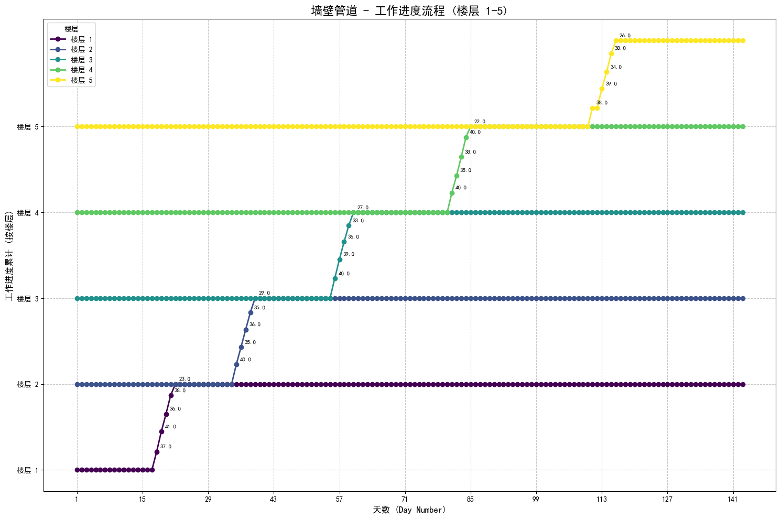
Pipes in the wall

Slide 27
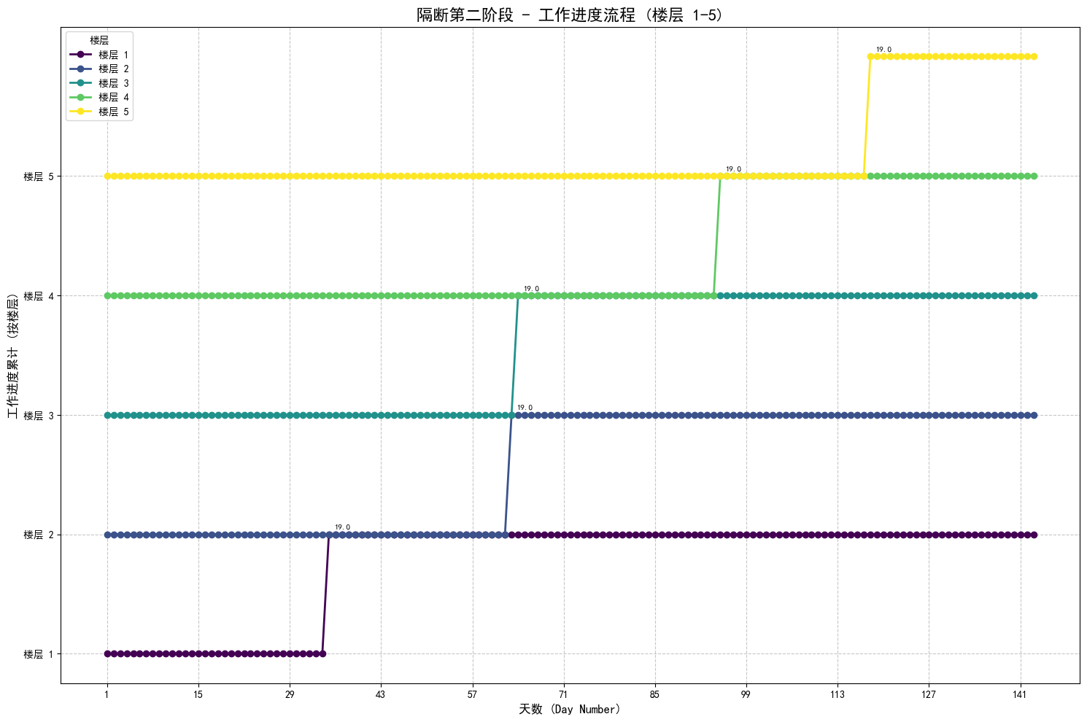
Partition phase 2

Slide 28
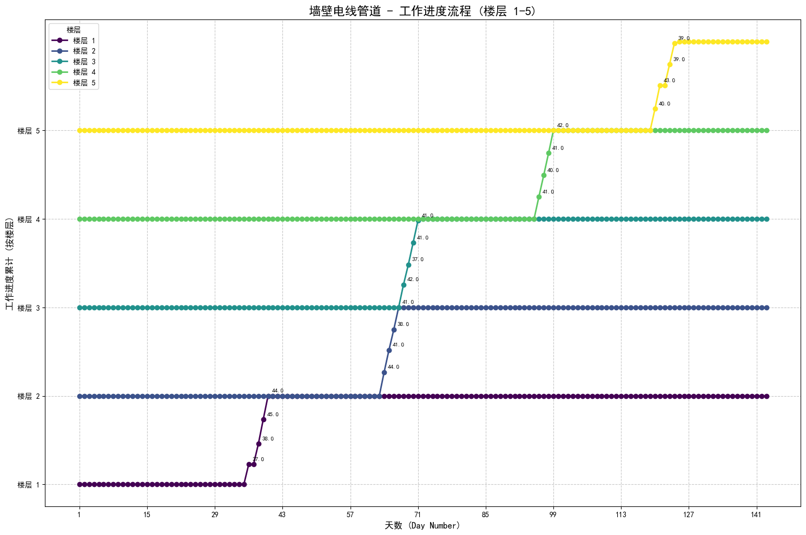
Electric conduits in the wall

Slide 29
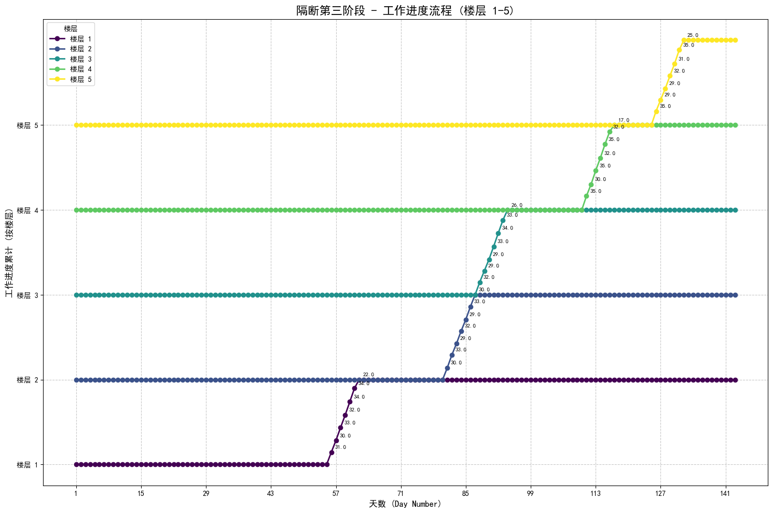
Partition phase 3

Slide 30
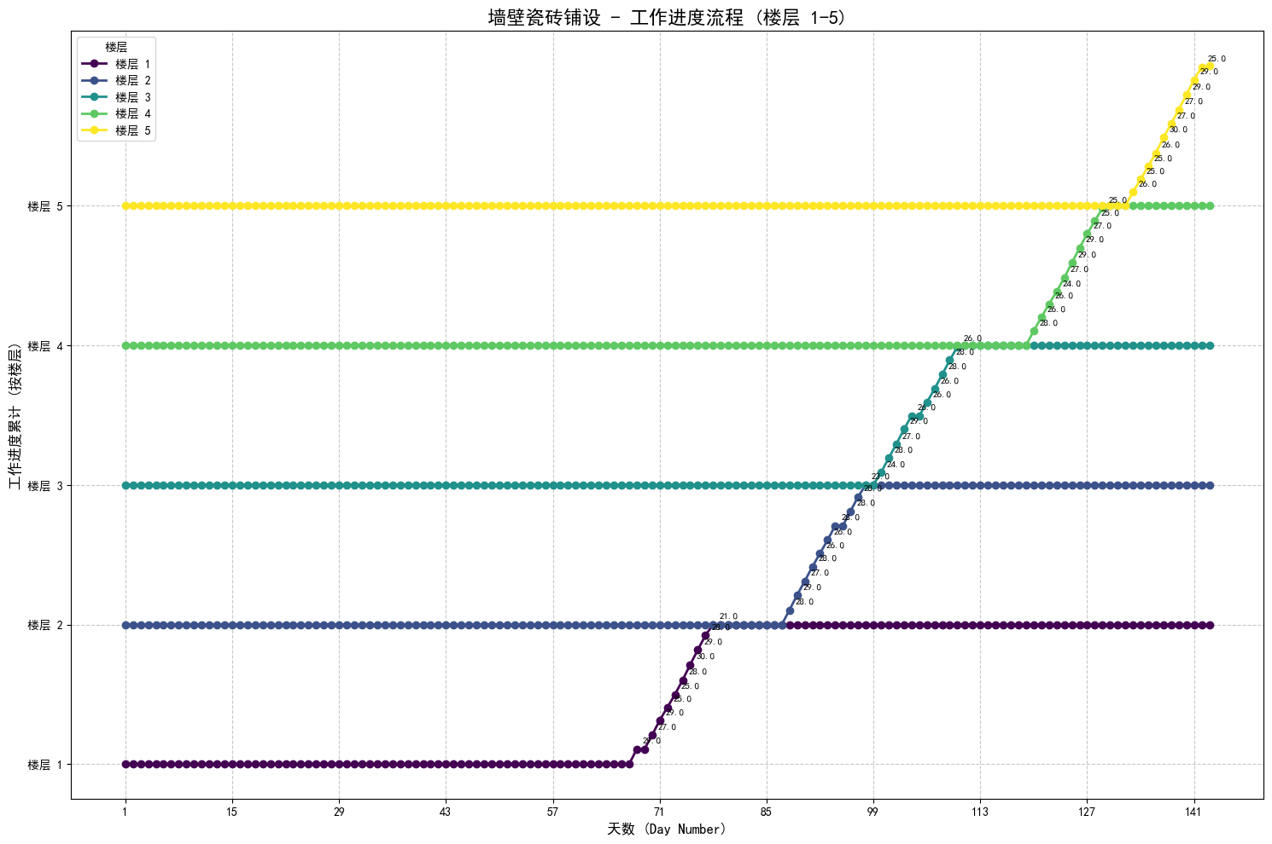
Wall tiling

Slide 31
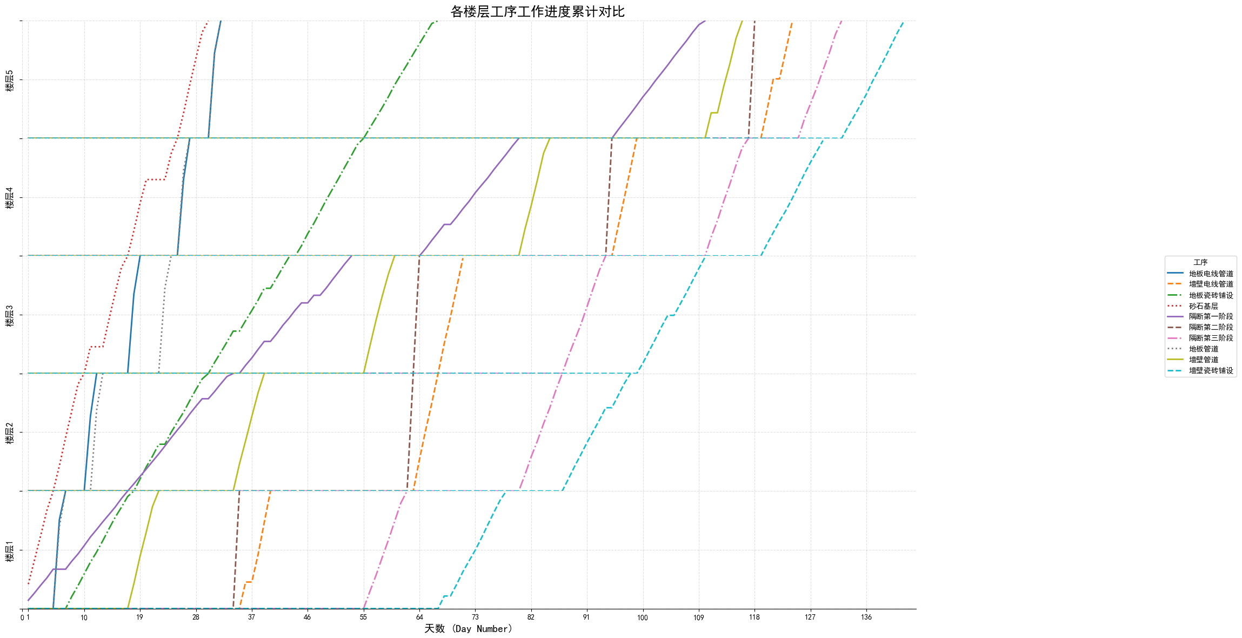

Slide 32
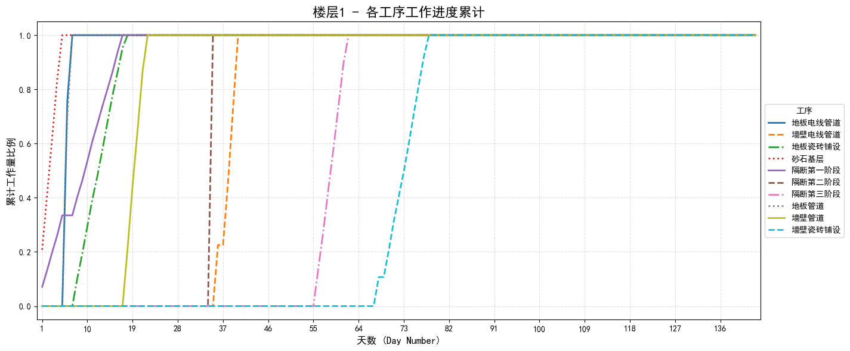

Slide 33
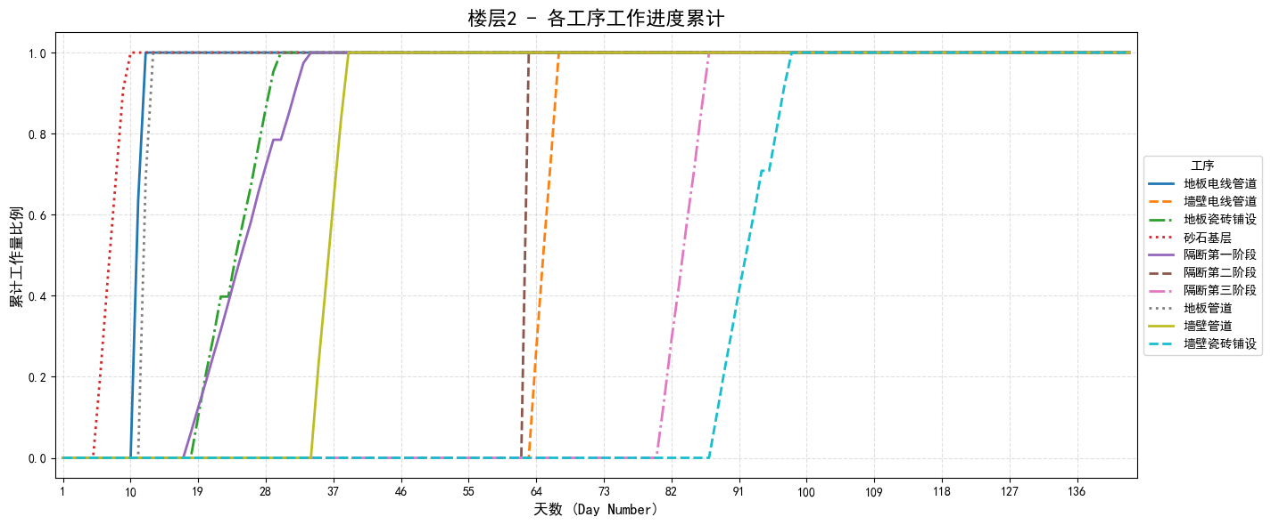

Slide 34
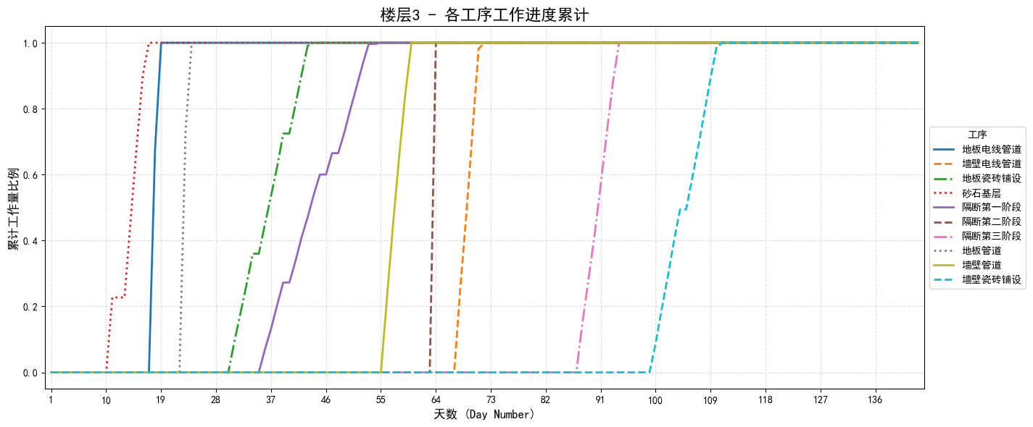

Slide 35
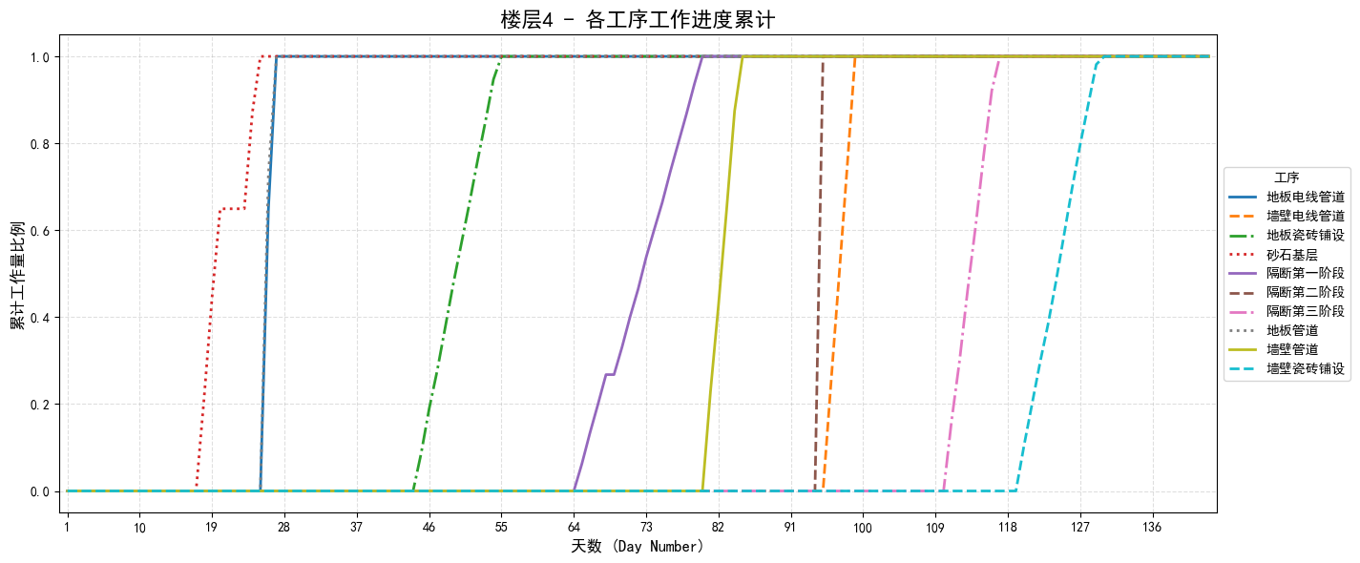

Slide 36
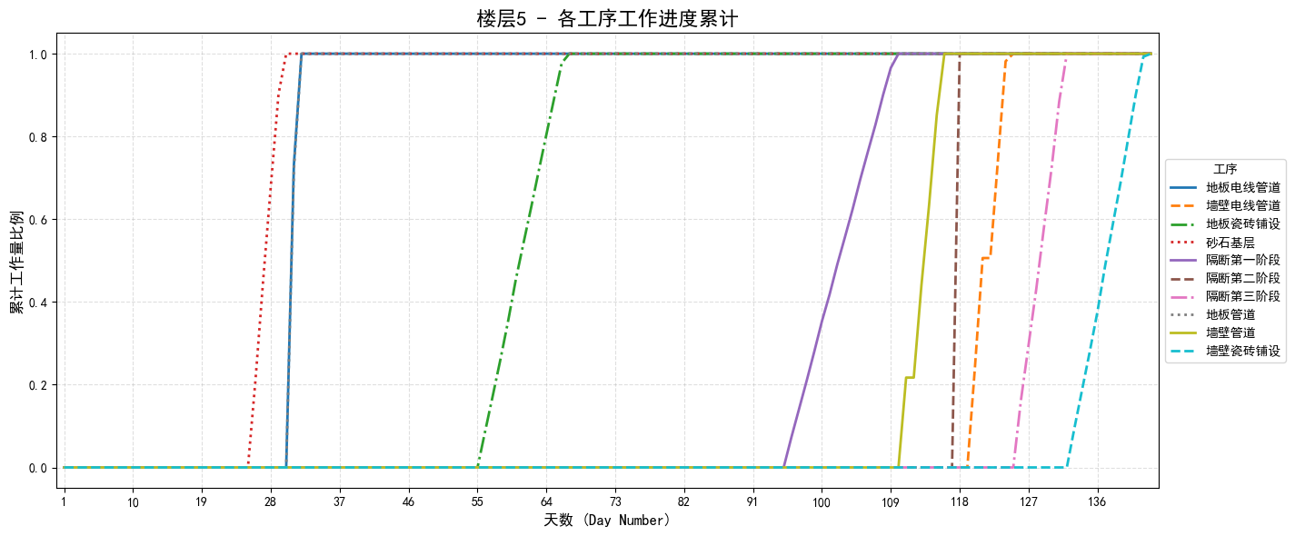

Slide 37
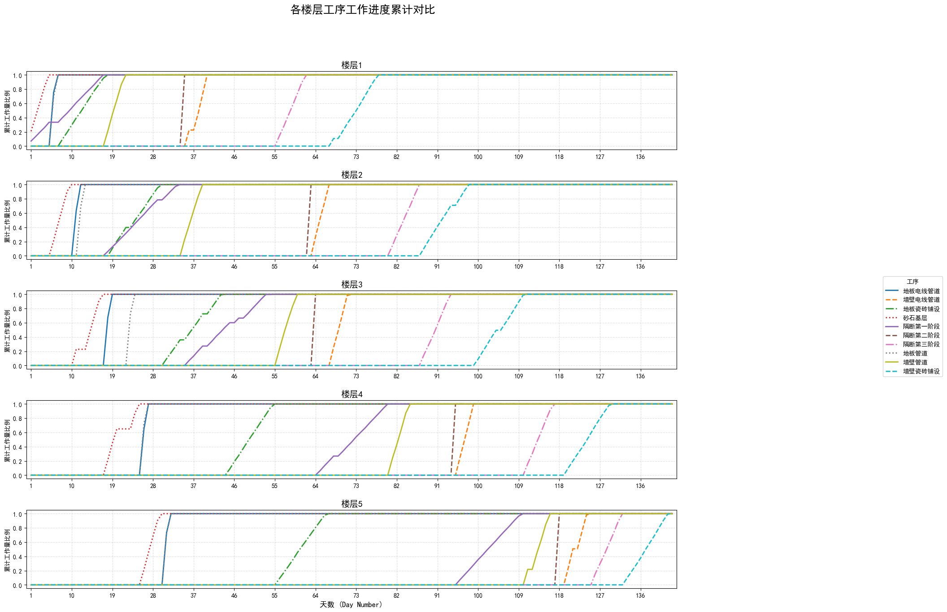

Slide 38
如何丰富/准确整个模拟过程？
day | floor | process | assigned_trade | task_status | initial_p_rate | remain_work | today_workload | predecessor_processes | pre_remain_work | trade_available | can_start
34 | 1 | Partition phase 2 | Partition | pending | 51 | 19 | 0 | Pipes in the wall | 0 | 1 | TRUE
55 | 2 | Partition phase 2 | Partition | pending | 51 | 19 | 0 | Pipes in the wall | 0 | 1 | TRUE
55 | 1 | Partition phase 3 | Partition | pending | 32 | 216 | 0 | Electric conduits in the wall | 0 | 1 | TRUE
62 | 2 | Partition phase 2 | Partition | pending | 51 | 19 | 0 | Pipes in the wall | 0 | 1 | TRUE
62 | 3 | Partition phase 2 | Partition | pending | 51 | 19 | 0 | Pipes in the wall | 0 | 1 | TRUE
63 | 3 | Partition phase 2 | Partition | pending | 51 | 19 | 0 | Pipes in the wall | 0 | 1 | TRUE
80 | 2 | Partition phase 3 | Partition | pending | 32 | 216 | 0 | Electric conduits in the wall | 0 | 1 | TRUE
55 | 1 | Partition phase 4 | Partition | pending | 40 | 180 | 0 | Electric conduits in the wall | 0 | 1 | TRUE
day | floor | process | Assigned trade | Task status | Initial v | Remain work | Expected time | Successor processes | Successor Remain work | Predecessor processes | Pre Remain work | Trade available | Can start
55 | 2 | Partition phase 2 | Partition | pending | 51 | 19 | 1 | Electric conduits in the wall | 200 | Pipes in the wall | 0 | 1 | TRUE
55 | 1 | Partition phase 3 | Partition | pending | 32 | 216 | 7 | Wall tiling | 150 | Electric conduits in the wall | 0 | 1 | TRUE
55 | 1 | Partition phase 4 | Partition | pending | 45 | 180 | 4 | Wall tiling | 150 | Electric conduits in the wall | 0 | 1 | TRUE
Successor processes | Successor Remain work | Initial v | Remain work | Expected time
Electric conduits in the wall | 200
Wall tiling | 150
Wall tiling | 150

Slide 39
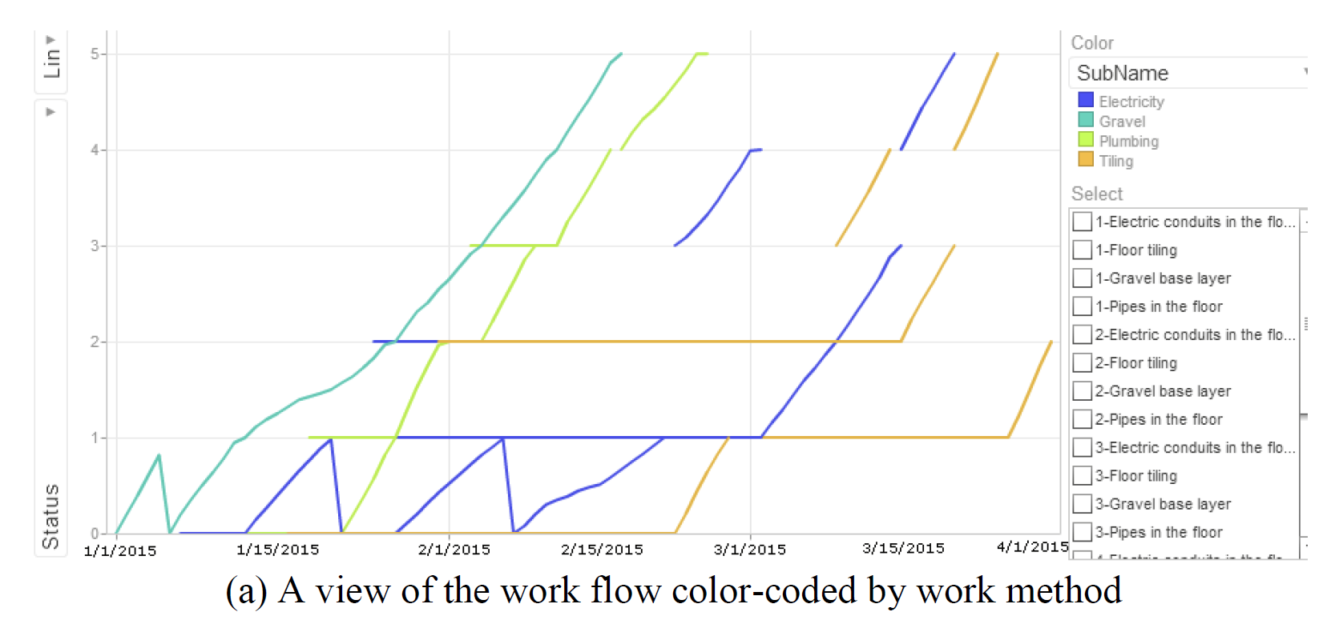
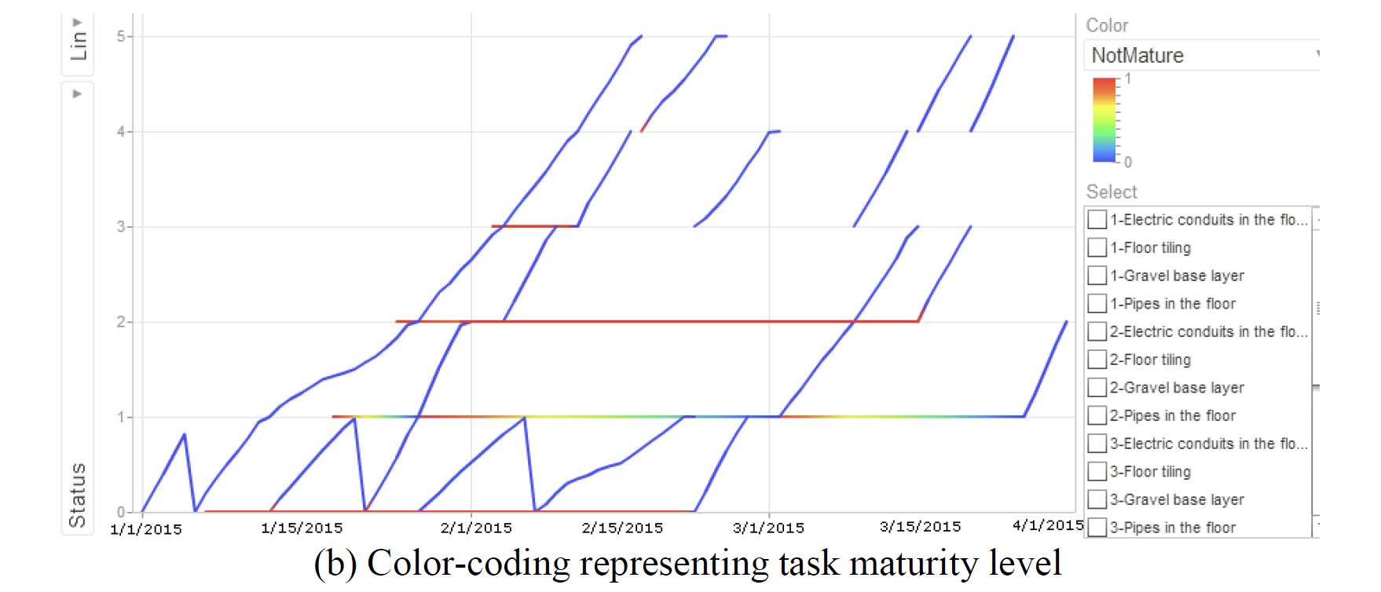
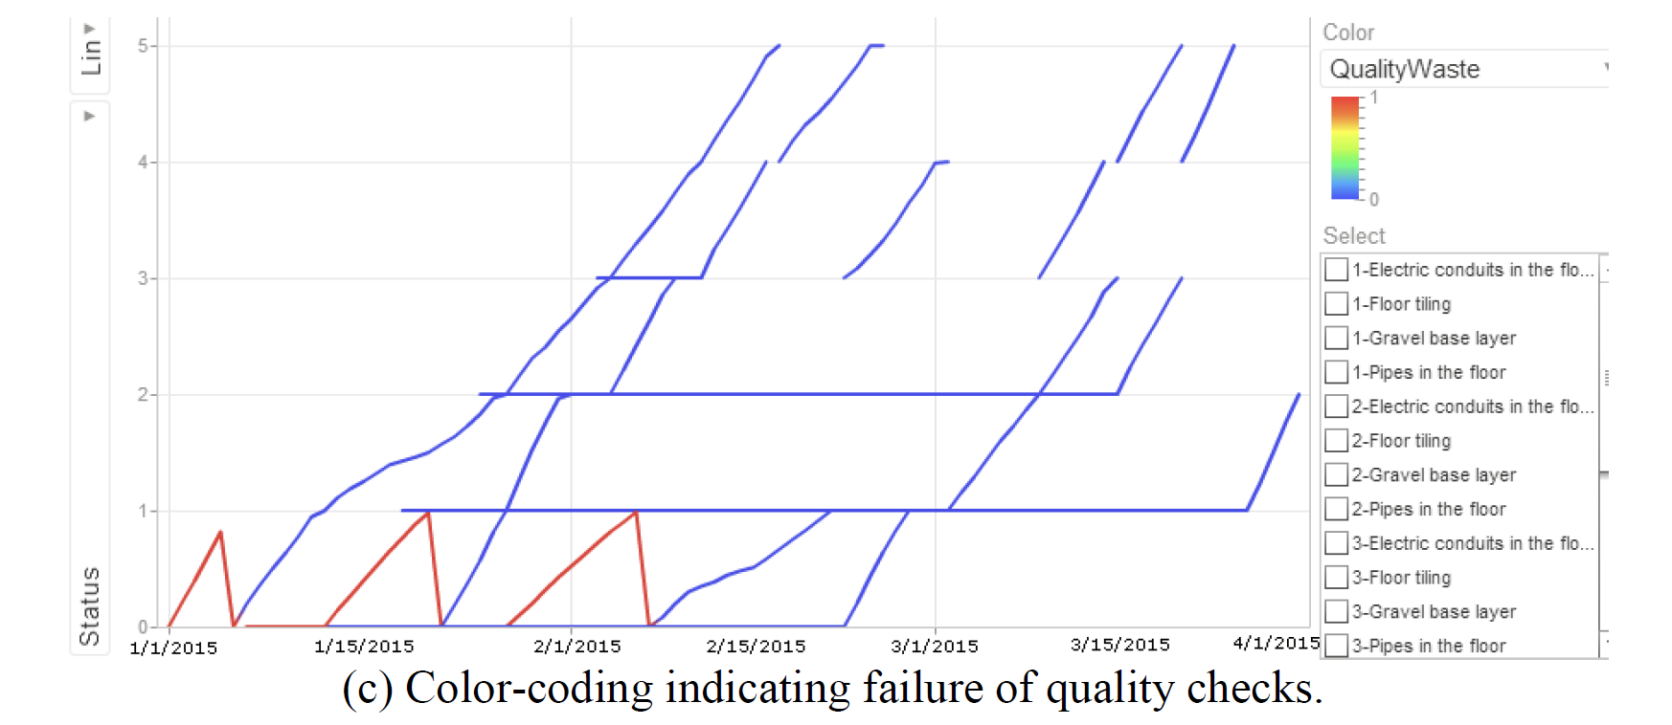
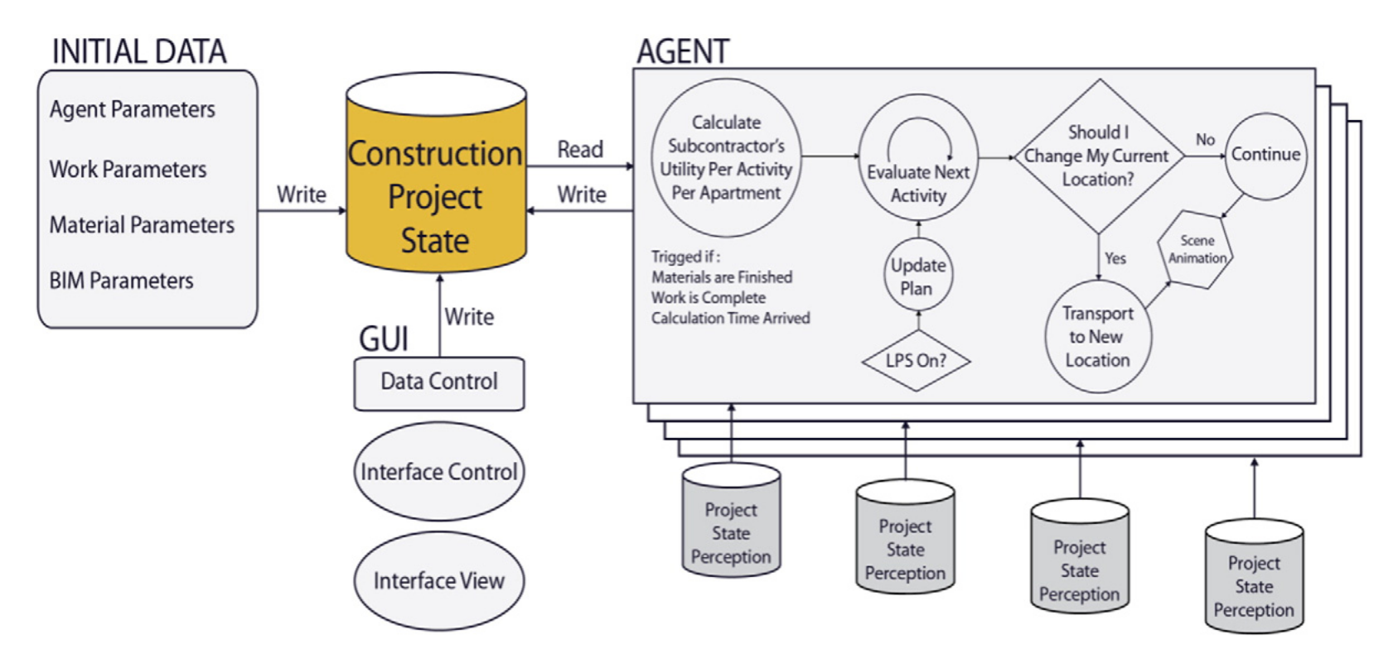
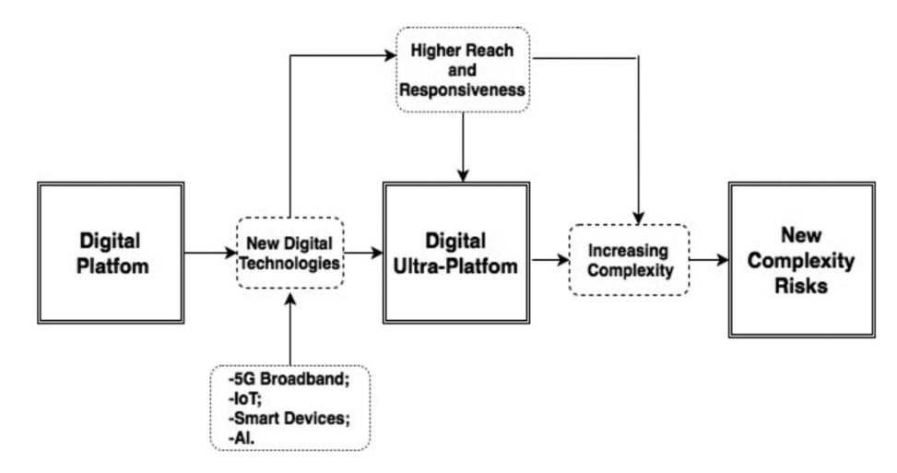
进一步研究
更加详细的过程模拟和过程可解释性…
利用人工智能对代理人数据建模，进而模拟预测建筑行业工作人员的行为…
Ma, L. and Sacks, R. (2016). ‘Agent-based simulation of construction workflows using a relational data model’ Proceedings of the 24th Annual Conference of the International Group for Lean Construction, Pasquire, C., Alves, T., and Reginato, J., (eds.), Boston, MA, US, July 2016, pp. 73-82.

Slide 40
谢谢

